Slide 1
Thrivers and Strugglers: The Balance Sheets and Financial Health of U.S. Families Assets Funders Network 2015 Grantmaker Meeting April 2015, Dallas
Ray Boshara
Senior Advisor; Director, Center for Household Financial Stability
Federal Reserve Bank of St. Louis www.stlouisfed.org/hfs
These are my own views, and not necessarily the views of the Federal Reserve Bank of St. Louis, Federal Reserve System, or the Board of Governors.

Slide 2
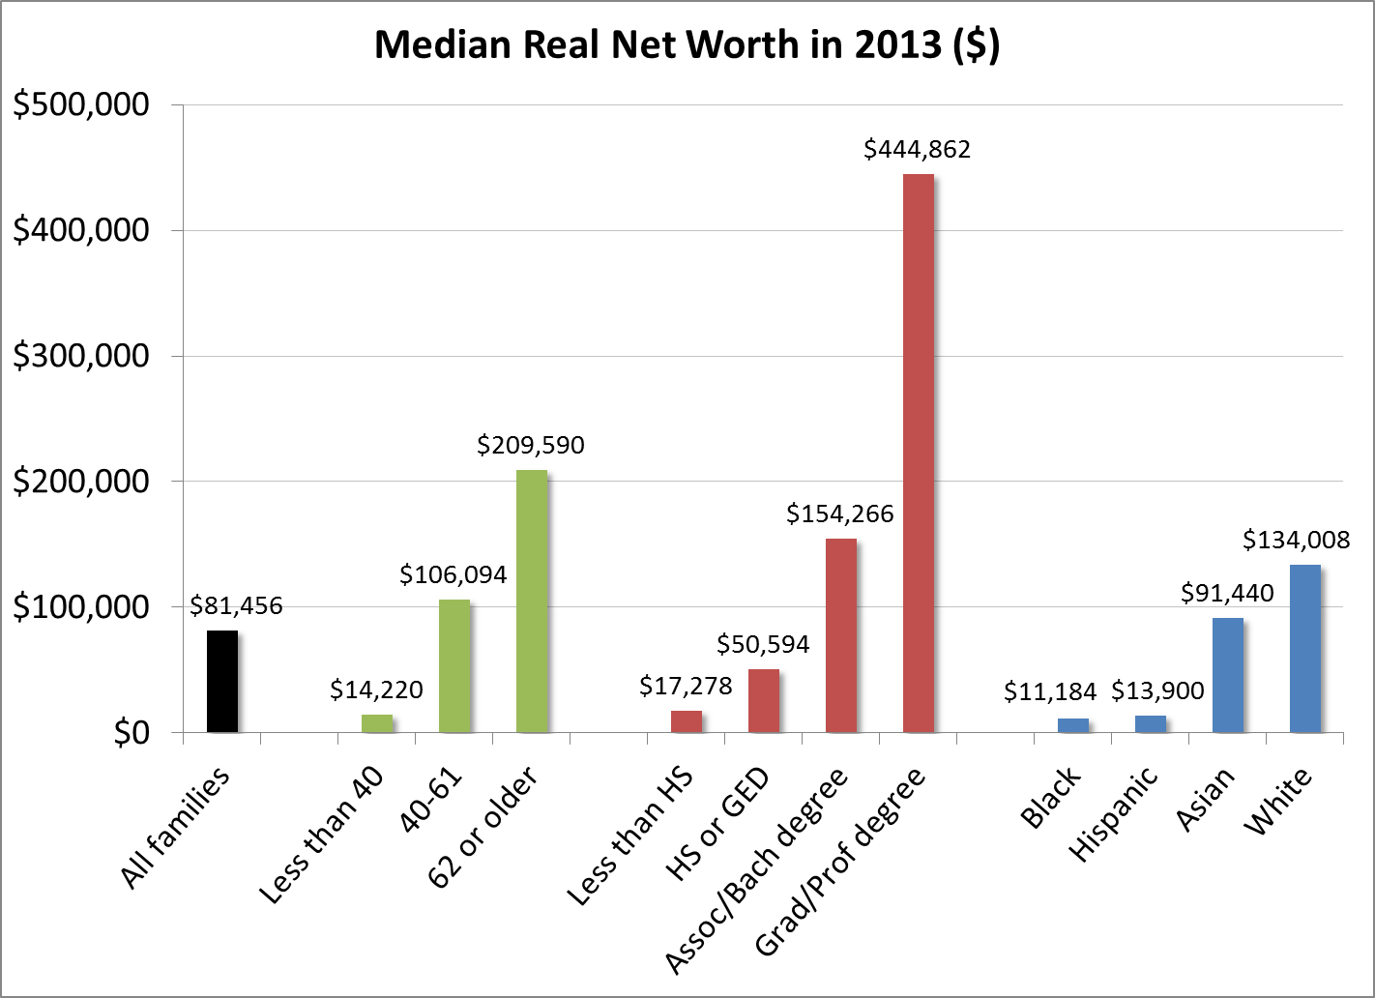
Net Worth by Age/Birth Year, Education, and Race/Ethnicity: (Emmons and Noeth, 2015. The Demographics of Wealth, Federal Reserve Bank of St. Louis)

Slide 3
New Economic Divide
1989
2013
Percentage of Population
Percentage of Total Wealth Owned
Source: Survey of Consumer Finances
Notes:
Thrivers are defined as white and Asian/other families 40 or older with a college degree.

Slide 4
Financial Health Scorecard
(Source: Survey of Consumer Finances; N=38,385 families, 1992-2013)
Did you save any money last year?
Did you miss any payments on any obligations in the past year?
Did you have a balance on your credit card after the last payment was due?
Including all of your assets, was more than 10 percent of the value in liquid assets?
Is your total debt service (principal and interest) less than 40 percent of your income?
Notes:
Did you save any money last year?
Did you miss any payments on any obligations in the past year?
Did you have a balance on your credit card after the last payment was due?
Including all of your assets, was more than 10 percent of the value in liquid assets?
Is your total debt service (principal and interest) less than 40 percent of your income?

Slide 5
Observations
Large disparities in wealth are driven, in part, by already economically vulnerable families assuming too much balance sheet risk – too much wealth in homeownership, financed with too much debt, and holding too few liquid assets – while encountering institutions not geared toward accumulating wealth. That is, both economic decision-making and institutions matter.
Age, even controlling for education and race, appears to be the strongest predictor of balance sheet health.
Differences in age and education explain very little of racial wealth gaps; the racial wealth gap is similar across age and educational levels.
Blacks and Hispanics have, on average, significantly lower incomes than whites and Asians, but also appear to have fewer opportunities to “convert” their incomes into appreciating assets.
The median income of Asian families has long surpassed that of whites and, if current trends continue, median Asian wealth will surpass median white wealth as well.
Education itself matters for wealth accumulation but other characteristics of people who obtain college and graduate degrees – family background, cognitive skills, “grit” – also contribute. In other words, even if everyone had the same college degree, a wealth gap would still exist.
No strategy alone – homeownership, education – is likely to result in closing the wealth gap. In fact, the returns on key assets such as homes, education, and savings, appear to be weaker among minority families.
A realist goal should not be to close the wealth gap, but to improve the financial health, balance sheets and lives of more struggling Americans.

Slide 6
Economic Trends Impacting Family Balance Sheets
Increasing income and expense volatility (U.S. Financial Diaries; Dynan et al.)
Debt overhang and prolonged recovery (Sufi and Mian; Emmons and Noeth); long shadow of a severe “balance sheet recession”
Family structure, especially the rise of single-parent households without college degrees (Putnam; Wilcox; Cahn and Carbone; Cherlin; Sawhill, etc.)
Returns to capital v. returns to labor; growing income and wealth inequality (Piketty; Stiglitz; Chetty; Saez; Krueger, etc.)

Slide 7
Ideas for Moving Forward
Consider demographic drivers of economic vulnerability, not just income
Start as early in life as possible to build a healthy balance sheet
Strive toward balance sheet diversification, beginning with the shorter-term liquidity needs of families
Think about influencing institutions, not just products and people
Notes:
Note Yellen’s call at the ALC for balance sheet diversification and liquid savings.
Blog post on SCF release, essays coming.
Our student loan work.

