Slide 1
City of San Antonio
Department of Human Services
Teamwork Integrity Innovation Professionalism
Training For Job Success

Slide 2
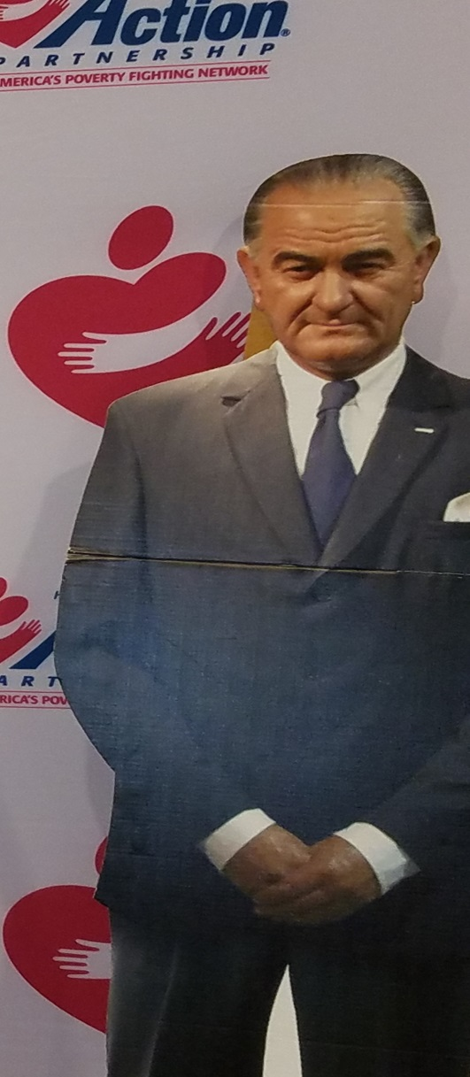
“Unconditional War on Poverty”
Lyndon B. Johnson in 1964 shaped the War on Poverty as a policy initiative
Johnson signed the 1964 Civil Rights Act, dismantling official segregation, the Voting Rights Act of 1965
Great Society to end poverty, reduce crime, improve the environment, and advance civil rights.

Slide 3
Poverty In America
Education
Job Training
Community Programs

Slide 4
There are 1,000-plus Community Action Agencies (CAA) both private and public across America.
Since 1979-City of San Antonio Department of Human Services (DHS) has operated as the designated Community Action Agency for Bexar County (CSBG).

Slide 5
Notes:
*

Slide 6
Case Management Services
Tuition Assistance
Textbooks
Uniforms
Career guidance, coaching, job referrals, interview skills training, resume development and career guidance.
Other services

Slide 7
TFJS Program Eligibility
Bexar County resident
At or Below the 125% of the FPL for Household size
HS Diploma/GED
Enrolled in an Educational Program-High Demand Occupation
at an Alamo Community College
Motivated & Committed to make a change
Claude Black Community Center
2805 E. Commerce St. SAT 78203
Notes:
Ms. Shana completed
Eligibility for CSBG is calculated at 125% of Federal Poverty Income Guidelines.
SOURCE: Federal Register, Document Number 2018-00814, Thursday, January 18, 2018

Slide 8
Case Management
Self-Sufficiency Model
Information, Education & Support
Screening/Assessment
Self Sufficiency Matrix
Client Engagement
Implement Plan
Review/Evaluate
Financial Literacy
Employment guidance & Support
Incentives/Encouragement
Notes:
Key Components of our Case Management Self-Sufficiency Model Include:
(Information, Education & Support)
Screening/Assessment-Target Occupations in High Demand Workforce
Self Sufficiency Matrix-explore areas of need and access Crisis
Client Engagement-Understanding the continuum of needs and services
Implement Plan-next steps
Review/Evaluate progress toward accomplishing their educational goals
Financial Literacy-collaboration with FEC
Locations: SAPL, Family Services Association
Employment guidance & Support- job readiness: interviewing skills, resume, job searches, soft skills to ensure long-term success.
Incentives/Encouragement-Portfolio, rolling back backs, flash drives, tumblers

Slide 9
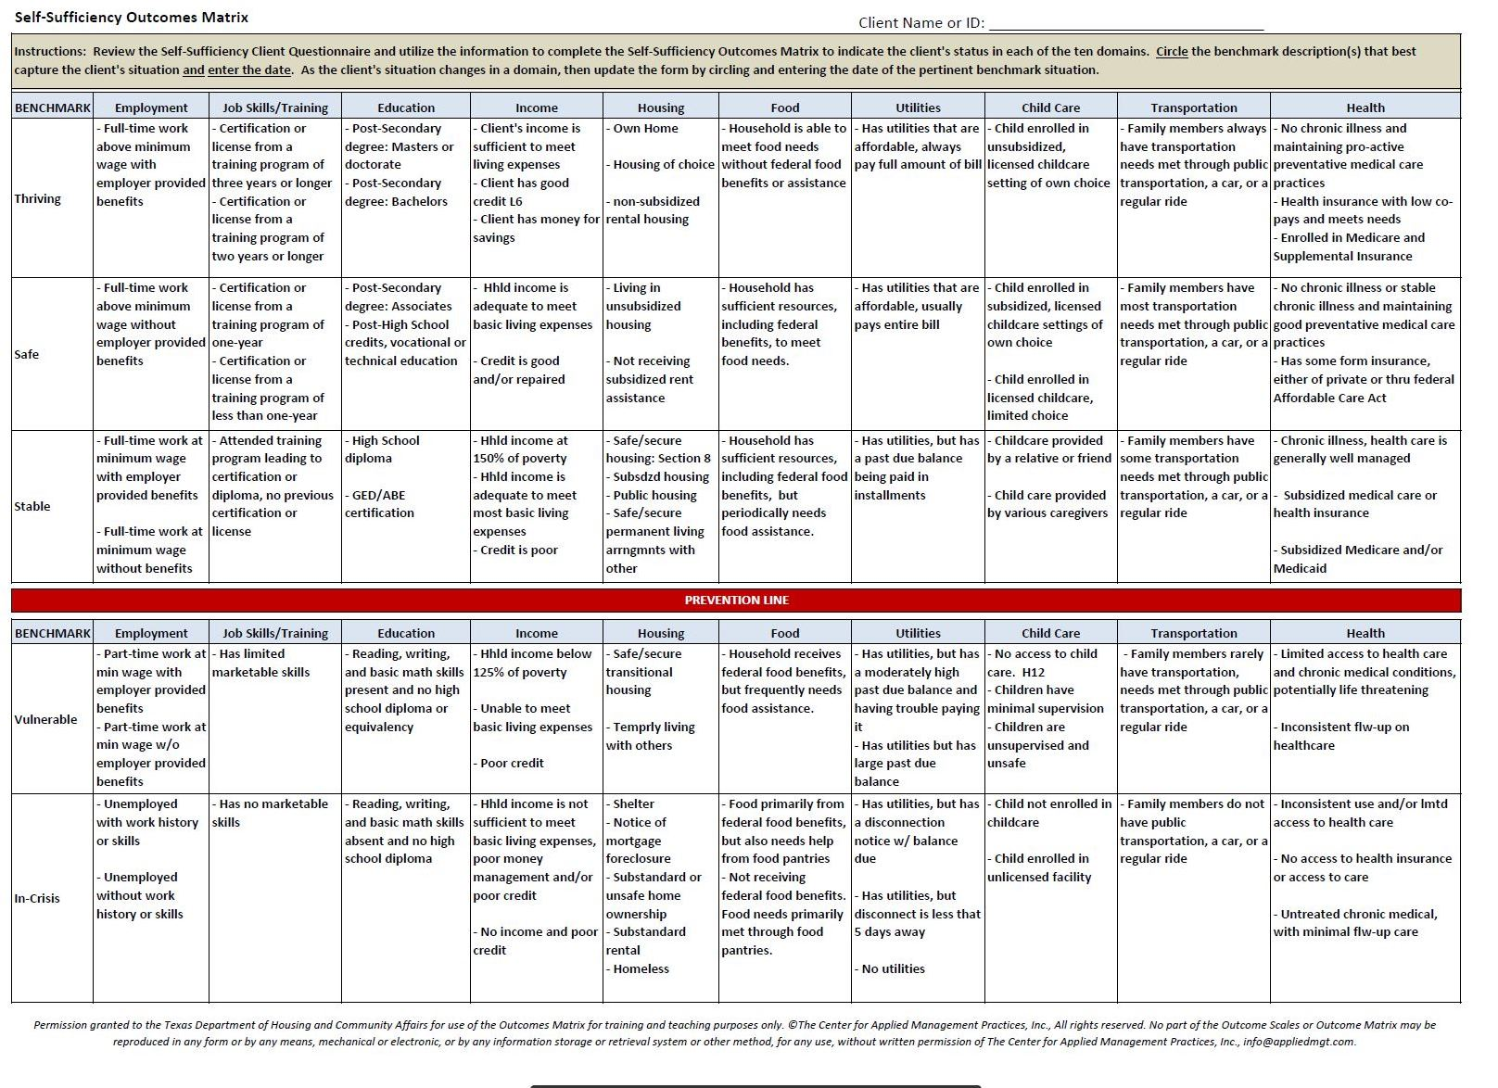

Slide 10
Debt reduction
Deal with debt collectors
Establish or Improve credit
Emergency Fund
Build Savings
Create a budget
Plan for Vehicle/Homeownership
Open a bank account

Slide 11
Claude Black Community Center -2805 E. Commerce Street
The Neighborhood Place- 3014 Rivas Street
Bazan Library-2200 W. Commerce
Westfall Library-6111 Rosedale Ct
Cortez Library-2803 Hunter St.
Carver Library-3350 E. Commerce

Slide 12
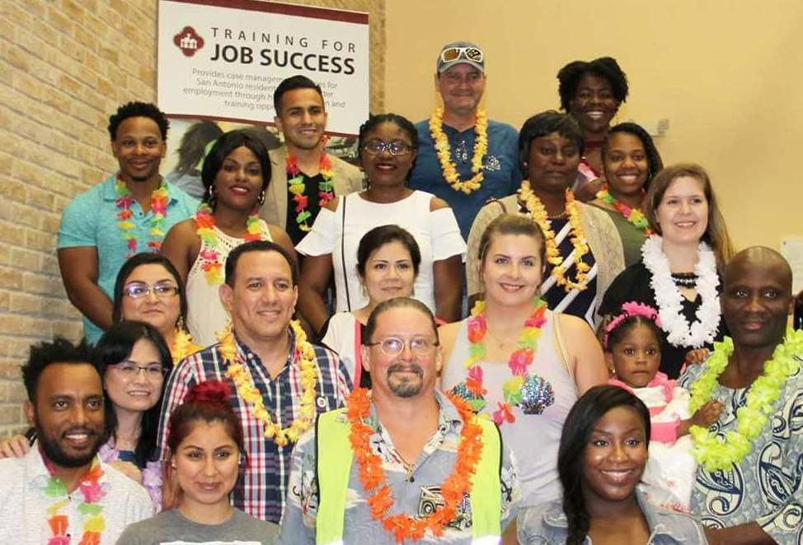
Celebrate Success
2018- program graduates annual earnings increased from $15,000 from entry to $52,818
post.
2018 -TFJS Transitioned 141 Individuals out of poverty.
9

Slide 13
Educational Supports
SAC-Empowerment Center -a career training, life-skills and college re-entry program, GED classes
https://www.alamo.edu/sac/about-sac/college-offices/advising/institutes/empowerment-center/
Phone: (210) 486-0455
Phone: 2Phone: 210-486-0455
10-486-0455
Notes:
.

Slide 14
Employment Support Resources
http://www.workforcesolutionsalamo.org/services-2/jobseekers/specialized-services
(210) 928-3985

Slide 16
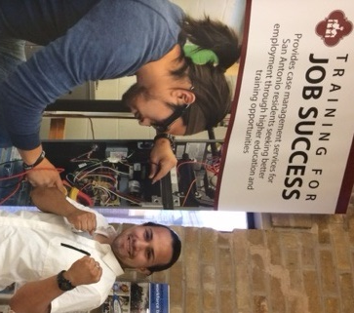
City of San Antonio
Department of Human Services
Teamwork Integrity Innovation Professionalism
Training For Job Success 210-207-5929

