Slide 1
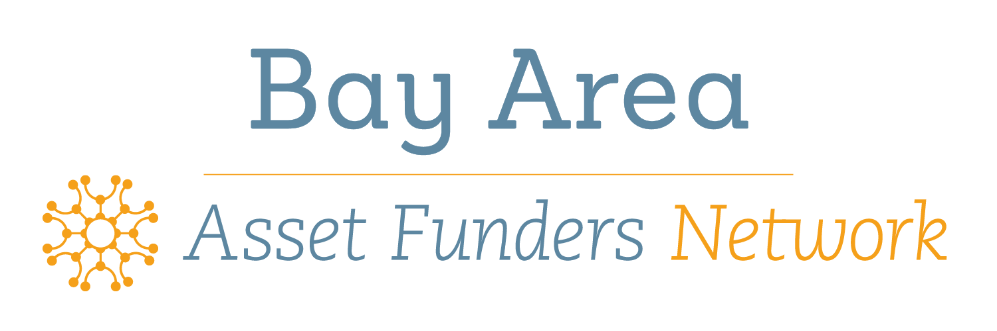


CALSAVERS: A CROSS-GENERATIONAL APPROACH TO ADDRESSING POVERTY THROUGH
PUBLIC-PRIVATE PARTNERSHIPS
March 14, 2019
Assetfunders @assetfunders

Slide 2



RETHINKING RETIREMENT IN CALIFORNIA

Slide 3

Contents
The problem
Solution: What is CalSavers?
Outreach & Engagement Strategy
Funding Opportunities

Slide 4
The Problem
  7.5 million Californians lack a workplace retirement plan
  Nearly half of California workers are on track to retire with incomes below 200% of the federal poverty level
  2/3 work for employers with < 100 employees; 58% are people of color; 58% are women
  Over 75% of California’s low and moderate income retirees rely exclusively on Social Security
  U.S. retirement savings gap is estimated between $6 trillion and $14 trillion.
  Median retirement savings for all working U.S. households is $3,000
Notes:
More Californians are retiring with very little savings,

Slide 5
What is CalSavers
Completely voluntary
Automatic
Low fee
Portable
Self-employed individuals welcome
No State or Taxpayer costs

Slide 6
Program Basics
Roth IRA; Traditional IRA as an elective option
Default Contribution Rate: 5%, with 1% automatic escalation to 8%
4 Investment Options, default for 1st $1,000 into Money Market with subsequent contributions defaulting into Target Date Fund
Employee fees decline as savings grow
Ease of use

Slide 7
Employer Benefits
Offers a retirement option with no/low administrative costs
No/low fiduciary liability
Minimal administrative complexity
Attracts talent, boosts morale and greater employee retention
Affordable and convenient option for small businesses

Slide 8
Eligibility in Counties*

Slide 9
Employee Barriers
Lack of access at work
Minimum opening deposit
Fees/Financial cost
Lack of financial education
Retirement feels far away compared to immediate needs

Slide 10
Age Profile
Source: CA Secure Choice Market Analysis and Feasibility Study By Overture Financial LLC, March 17, 2016

Slide 11
Employee Profile
What is their average income?
  $35,146
Where do they work?
  13.3% Retail
  12.3% Accommodation and Food Service
  11.0% Manufacturing
  11.0% Health Care and Social Services
  Other top fields: Management/Administration/Support Waste Management Services; Wholesale, Transportation & Warehousing; Construction

Slide 12
Savings Potential
Workers with a payroll deduction savings option are 15 times more likely to be on a path to retirement security
AND
20 times more likely to save when they are automatically enrolled in a program

Slide 13
Impact of CalSavers

Slide 14
Implementation Timeline
Pilot Program
Employee Enrollment
December 2018 (Ongoing)
First Wave
Registration Deadline
Employers with 100+ employees must register by June 30, 2020
Pilot Program Ends
June 30, 2019
Third Wave
Registration Deadline
All employers with 5+ employees must register by June 30, 2022
CalSavers.com
Live October 20th
2018
2021
2022
2019
2020
Pilot Program
Employer Registration
November 2018 (Ongoing)
All Employer Registration Begins
July 1, 2019
Second Wave
Registration Deadline
Employers with 50-99 employees must register by June 30, 2021
Pilot Program
First Contributions
January 2019

Slide 15
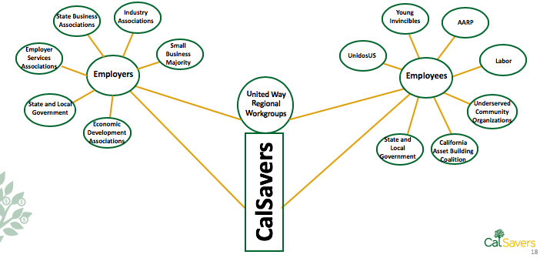
CalSavers: Powered by Partners

Slide 16
Role of Regional Workgroups
Identify & recruit CalSavers champions
Serve as CalSavers spokespeople
Distribute CalSavers information
Identify/sponsor promotional events
Identify funders
Identify pilot employers

Slide 17
Building Capacity of Stakeholders
Opportunities to Strengthen CalSavers Outreach
Expand coverage and reach of United Way regional work groups
Support engagement of key business associations and CBO’s in UW work groups
Expand capacity of state/local organizations serving youth, immigrants, Latinos, African Americans, and the API communities to spread the word.
Support media efforts to reach underserved communities (e.g. Univision)

Slide 18

Questions & Answers

Slide 19

More Information
For more information or to enroll, please go to: CalSavers.com
Sign up to receive updates www.treasurer.ca.gov/scib
Follow CalSavers on Twitter @CalSavers
@UnitedWaysCA

